Slide 1

Glénat Acquisition Assessment
Cover
INVESTMENT COMMITTEE SCREENING MEMO | FEBRUARY 2026
CONFIDENTIAL | PREPARED FOR INVESTMENT COMMITTEE
SOURCE: Nexus analysis
Nexus | 0

Slide 2
Proceed to formal due diligence on Glénat at 6.5-7.5x EBITDA (€195-225M EV)
Target 20%+ IRR through three-lever value creation plan delivering €8-12M EBITDA uplift
France is the largest manga market outside Japan at ~€285M, with structural growth 25-30% above pre-pandemic levels despite 7.7% normalization in 2025
Global value chain: $10-19B across publishing ($5-8B, 10-20% EBITDA), licensing ($12-15B, 40-60% margin), merchandising ($2-3B), anime/streaming ($3-5B)
French market: peaked at €353M in 2021, normalizing to ~€285M; manga represents 50-57% of all French comics volume
Glénat leads French manga at ~30% share with €146M revenue and 21% EBITDA margin, but faces competitive pressure from Pika and Kana
Financials: €30.5M EBITDA (21% margin), €19.7M net profit, 78.9% gross margin, €86.9M equity (2023)
Competitive set: Glénat #1 (~30%), Kana #2, Pika #3 (rising fast with aggressive title acquisition), Kurokawa #4
Category normalization and IP concentration create underwriting risk: market down 7.7% YoY, One Piece represents 10-15% of French manga volume
Volume backdrop: investors must underwrite a flatter trajectory versus 2020-21 demand surge
Franchise dependency: One Piece = 10-15% of category volume; rights shock or consumer fatigue would disproportionately hit topline
Proceed at 6.5-7.5x EBITDA (€195-225M EV) supported by comps: EU publishing 5.3x, PRH 6.9x, KKR/S&S 8.0x
Value creation bridge: digital ~2% today to 10%+ (vs 66-73% Japan); print economics 300-500bps margin uplift; licensing engine captures 40-60% margin pools
Deal protections: earn-out tied to diversification KPIs, management retention, minimum rights tenure, pipeline representations
Execute via licensing and digital flywheel: anime adaptations drive 2x+ sales uplift, while print optimization delivers 300-500bps margin expansion
Anime catalyst: adaptations deliver 2x+ sales uplift for adapted titles; formalize streaming partnerships to prioritize Glénat catalog
Digital unlock: scaling from ~2% to 10%+ penetration expands reach to younger cohorts and improves unit economics vs print-only
IC action requested: Approve proceeding to formal due diligence and the 6.5-7.5x EBITDA (€195-225M EV) indicative range
Source: GfK/Livres Hebdo; Pappers.fr (Glénat financials 2023); comparable transaction analysis; team analysis
Nexus | 2

Slide 3
Manga value chain spans 5 segments from IP creation to merchandising, with licensing capturing the highest margins at 40-60%
IP Creation
Publishing
Licensing / IP
Anime / Streaming
Merchandising
Market size
Market size
Market size
Market size
Market size
Upstream
$5-8B
$12-15B
$3-5B
$2-3B
EBITDA margin
EBITDA margin
EBITDA margin
EBITDA margin
EBITDA margin
n/a
10-20%
40-60%
30-50%
50-75%
Key activities
Key activities
Key activities
Key activities
Key activities
Manga creation by mangaka (artists/writers)
Translation, adaptation, print and digital distribution
Character licensing for products, gaming, experiences
Anime production and global streaming distribution
Figurines, apparel, collectibles, events, conventions
Serialization in magazines (Weekly Shonen Jump)
Print still 98% in France vs 66-73% digital in Japan
Highest-margin segment at 3-4x publishing EBITDA
Drives 2x+ manga sales uplift for adapted titles
Highest unit margins (50-75%) but smaller total pool
Rights controlled by Japanese publishers
Fixed-price book law (loi Lang) protects margins
Largely untapped outside Japan
Sony/Crunchyroll acquisition at $1.175B signals IP premium
Growing fast with mainstream adoption of manga culture
Key players
Key players
Shueisha, Kodansha, Shogakukan
Key players
Bandai Namco, Toei Animation, Sony
Key players
Key players
Relevance for Glénat
Glénat (#1, ~30%), Kana, Pika, Kurokawa, Ki-oon
Relevance for Glénat
Crunchyroll/Sony, Netflix, ADN (Kazé)
Bandai, Good Smile, Japan Expo organizers
Rights acquisition is critical; long-term relationships with Shueisha (One Piece) are Glénat's core competitive moat
Largest value creation opportunity; build licensing engine to monetize catalog across merch and media
Relevance for Glénat
Relevance for Glénat
Flywheel effect: anime exposure drives print demand; partnership strategy is key lever
Relevance for Glénat
Core business today; €146M revenue, 21% EBITDA margin, 78.9% gross margin
Adjacent revenue stream; build via licensing engine and event partnerships
Rights flow downstream
Revenue scales with IP popularity
Margins increase downstream
Anime drives 2x+ print uplift
Highest unit economics
Sources: Grand View Research (2025), Mordor Intelligence (2025), Statista (2024), team analysis
Nexus | 3

Slide 4
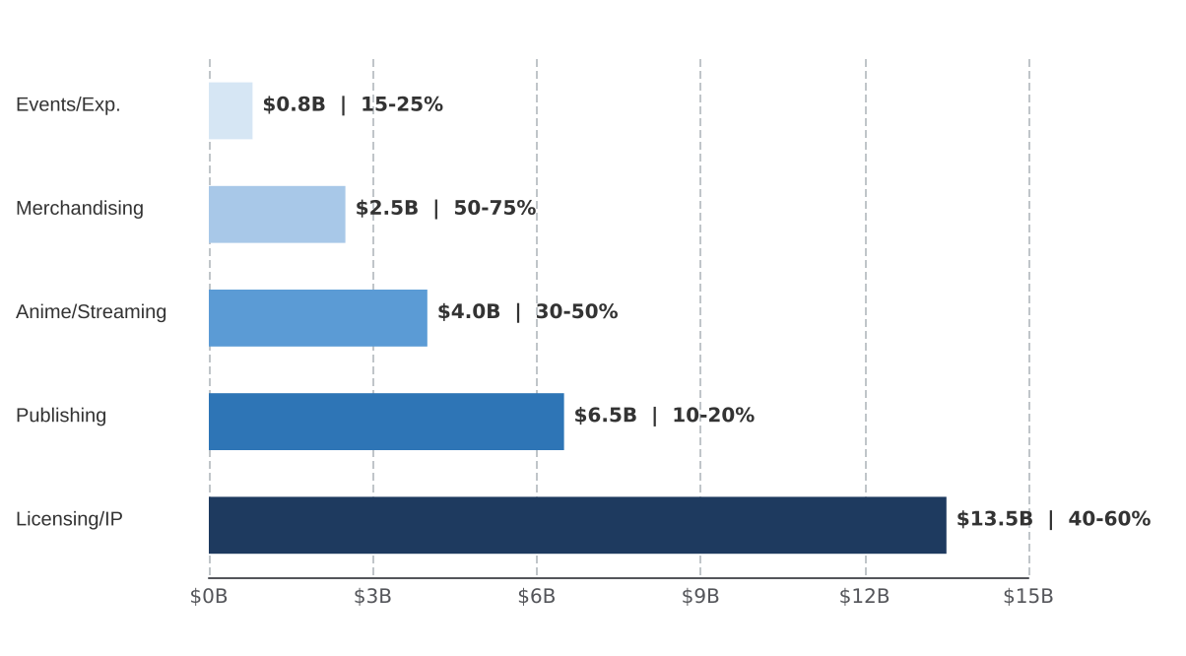
Global manga value chain is $10-19B growing 8-20% CAGR
Licensing generates 3-4x the EBITDA margin of traditional publishing
Manga value chain segments by estimated market size and EBITDA margin
Key market data points
Market size ($B, approximate midpoint), EBITDA margin range (%)
Global manga market consensus: $13-15B in 2025 (range: $10.2B Grand View to $19.4B Mordor Intelligence)
CAGR to 2030: 7.8-20.5% depending on analyst and segment definition
Japan domestic: ~$4.7B in 2024 (704.3B yen), 7th consecutive year of growth
Digital now 66-73% of global manga revenue, accelerating post-pandemic shift
Licensing/IP is the largest and highest-margin segment, generating 3-4x the EBITDA margin of traditional publishing
Sources: Grand View Research (2025), Mordor Intelligence (2025), Straits Research (2025), Statista (2024)
Nexus | 3

Slide 5
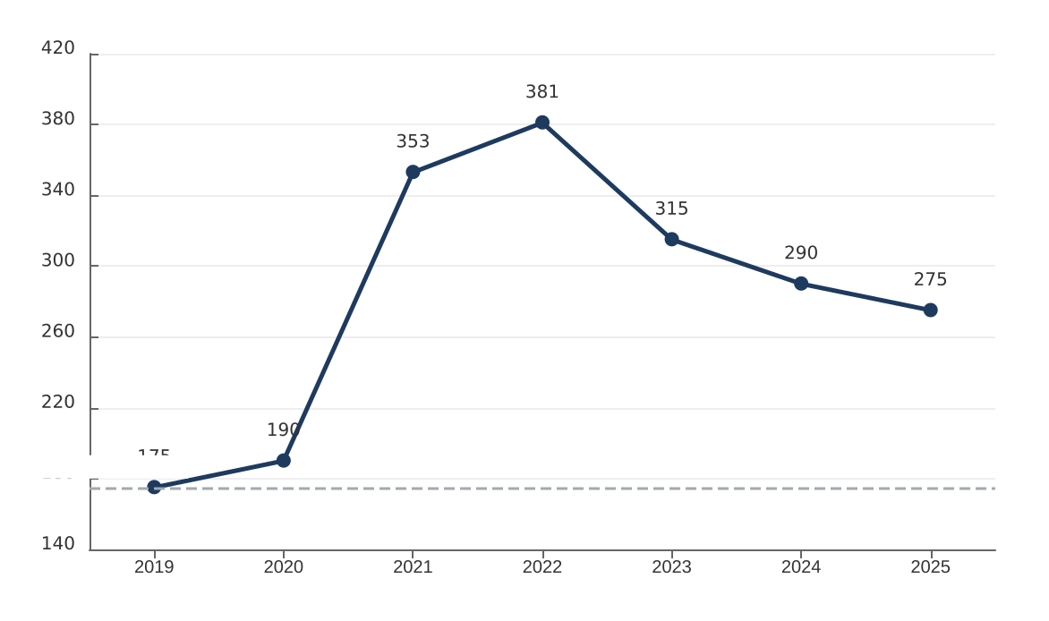
France is the #1 manga market outside Japan at ~EUR285M
Post-peak normalization demands selective positioning
French manga market revenue (EUR M), 2019-2025
Key market dynamics
Line chart showing French manga market revenue trajectory 2019-2025
2021 peak: 47M copies, EUR353M representing a 2x increase vs. 2019 pre-pandemic levels
Manga = 50-57% of French comics by volume, dominating the broader BD market segment
Physical retail = 98% of sales; fixed-price book law (loi Lang) protects publisher margins
Culture Pass effect: only 6%; 94% of growth driven by anime-streaming exposure
2025 market still 25-30% above pre-pandemic levels despite post-peak normalization
Pre-pandemic baseline
Sources: GfK France (2022), Livres Hebdo (2025), NielsenIQ BookData (2025), ACBD
Nexus | 4

Slide 6
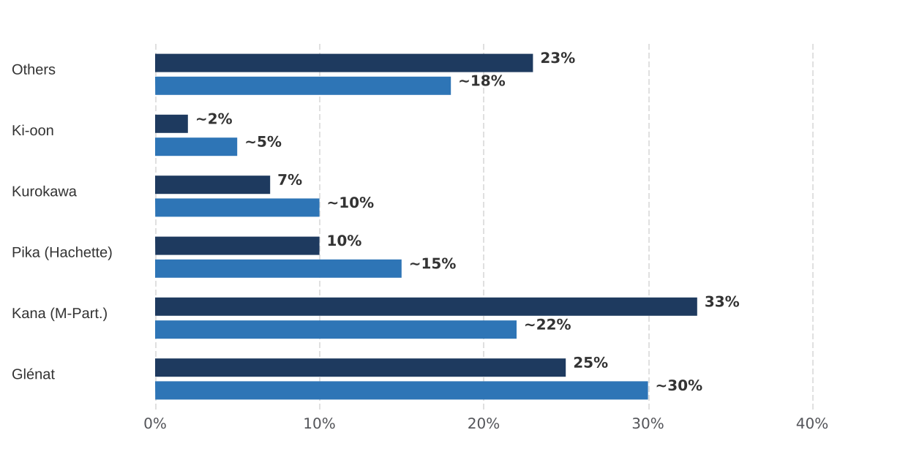
Glénat leads French manga, but Pika and Kana are gaining share
2007 share
~2024 est.
French manga publisher market share
% of manga market volume, 2007 vs ~2024 estimated
Competitive dynamics
Glénat anchors on One Piece (51M+ copies in France, 6 of top 10 bestselling manga in 2024)
Pika gaining fast: Blue Lock, Demon Slayer, My Hero Academia, Jujutsu Kaisen, Chainsaw Man
Kurokawa differentiates via premium editions (Berserk deluxe at €49.99)
Kazé/Crunchyroll: vertically integrated with anime streaming
Top 4 publishers estimated at 65-75% combined market share
Sources: Comipress (2007 data), Statista (2019-2024), Livres Hebdo, ComicsBeat (2024)
Nexus | 5

Slide 7
Glenat generates EUR146M revenue with 21% EBITDA margin and EUR86.9M equity
Strong financial platform for acquisition: high margins, lean cost structure, robust balance sheet
REVENUE
EBITDA
NET PROFIT
EQUITY
EUR146M
EUR30.5M
EUR19.7M
EUR86.9M
FY 2023
20.9% margin
13.5% margin
Book value
+42% YoY
Financial Summary (2020-2023)
Metric
2020
2021
2022
2023
Revenue (EURM)
67.5
108.0
103.0
146.0
EBITDA (EURM)
15.3
35.7
31.1
30.5
Net Profit (EURM)
9.7
24.2
18.4
19.7
EBITDA Margin
22.7%
33.1%
30.2%
20.9%
Gross Margin
n/a
n/a
n/a
78.9%
Exports (EURM)
n/a
n/a
n/a
14.3
Company Profile
Founded 1974, HQ Grenoble, SAS with EUR5M capital
92-199 employees; personnel costs EUR9.32M (6.4% of revenue)
Holding: Glenat Entreprises et Developpement (EUR99M balance sheet)
Key franchises: One Piece (51M+ copies), Dragon Ball (33M), Naruto (35M)
Catalog: ~200-300 manga titles; pioneered French manga with Akira (1990)
Source: Pappers.fr (2023 filing), Societe.com, Glenat corporate records
Nexus | 6

Slide 8
Anime adaptations drive 2x+ manga sales uplift in France
Rights positioning emerges as the critical competitive moat for manga publishers
Key evidence: anime-to-manga sales flywheel
Evidence area | Key finding
Demon Slayer print impact | 200,000+ copy first print runs in France following anime/film release, consistently in top 10 French manga sales 2021-2025
Franchise saturation | One Piece Film Red: 972,774 theatrical tickets sold in France (Aug 2022), but saturated franchises show limited incremental manga uplift
Culture Pass analysis | Government stimulus accounted for only 6% of 2021 volume surge; 94% of growth attributed to anime-driven reader enthusiasm
Fresh vs. concluded | Fresh franchises (Demon Slayer, Spy x Family, Jujutsu Kaisen) show strongest sales uplift from anime; concluded series show diminishing returns
Japan digital shift | 73% of manga sales now digital; Crunchyroll co-produces 200+ anime (20-25% of lineup), reshaping distribution economics
Streaming licensing | Minimum guarantees of $70K-$150K per territory for B-grade anime; major franchises command $5-25M multi-territory deals
Implication for the fund
Rights positioning and franchise pipeline are more valuable than current catalog size for long-term competitive advantage
Due diligence priority: Glenat's rights tenure, renewal terms, and pipeline of upcoming anime adaptations for existing catalog titles
Risk factor: concluded franchises and saturated series provide limited incremental value from new anime content
    Key question: what share of Glenat's catalog has active anime pipelines vs. dormant or concluded titles?
Sources: GfK France, Livres Hebdo, Crunchyroll investor data, industry interviews
Nexus | 7

Slide 9
Three levers target €8-12M EBITDA uplift across digital, licensing, and print
Value creation plan: digital acceleration, licensing engine, and print economics optimization
Digital & DTC Acceleration
Licensing / IP Engine
Print & Working Capital
€3-5M EBITDA uplift
€3-4M EBITDA uplift
€2-3M EBITDA uplift
France digital manga at ~2% penetration vs 66-73% in Japan, representing massive untapped headroom for growth
Target: grow digital from ~2% to 10%+ of sales via simulpub releases and subscription models
Digital gross margin 50-60% vs 35-45% for print; eliminates 10-15% manufacturing and 5-8% logistics costs
Net margin improvement: 13-18 pp on each unit of volume shifted from print to digital channel
Licensing EBITDA margins 40-60% vs 10-20% for traditional publishing, with near-zero incremental cost base
Build dedicated rights function: translation rights, audiobooks, games, collectibles, and merchandise
Benchmarks: Toei Animation 35-45% licensing margin; Bandai Namco IP segment achieves 35-40% margin
Publisher licensing royalties: 85-95% gross margin on IP fees with minimal overhead required
Returns rates at 20-40% of printed volumes under French consignment system, destroying margin
Target: reduce returns by 5-10 pts via advanced demand forecasting and print-on-demand integration
Retailer discount ~30-35% in France vs 40% in US; favorable cost structure to preserve
Working capital release: €3-5M from improved inventory turns and reduced overprinting
Combined target: €8-12M EBITDA uplift through margin-accretive digital shift, high-margin IP monetization, and operational efficiency gains across the print value chain
Sources: Industry benchmarks, Toei Animation FY2024, Bandai Namco FY2024, publisher economics analysis
Nexus | 8

Slide 10
Comparable transactions support 6.5-7.5x EBITDA for Glénat
Implied enterprise value range of €195-225M based on €30.5M EBITDA (2023)
Comparable Transactions
Glénat Valuation Scenarios
Transaction
Year
EV
EV/EBITDA
EV/Rev
Notes
Based on EBITDA of €30.5M (2023)
KKR / Simon & Schuster
2023
$1.62B
~8.0x
~1.25x
Premium publisher
Multiple
EV (€M)
Context
Bertelsmann / PRH (100%)
2020
$3.67B
~6.9x
~1.1x
World's largest
5.3x (floor)
€162M
EU baseline
Vivendi / Lagardère
2022
€2B (57%)
~5-6x
n/a
French media
6.5x
€198M
Low end of range
7.0x (mid)
€214M
Recommended target
Sony / Crunchyroll
2021
$1.175B
n/a
15-23x
Digital platform
7.5x
€229M
High end of range
Blackstone / Infocom
2024
$1.7B
n/a
n/a
Japan digital comics
8.0x (ceiling)
€244M
Premium, KKR-level
EU mid-market baseline
H1 2025
-
5.3x
-
Dealsuite, 828 firms
PE publishing deal volume up 72% in H1 2024 vs H2 2023, indicating favorable seller market conditions
Sources: Dealsuite H1 2025, FTI Consulting (2024), company filings, financial press
Nexus | 9

Slide 11
Proceed with diligence at 6.5-7.5x EBITDA with four structural protections
Against franchise concentration and market cyclicality
Risk
Mitigant
One Piece franchise concentration (10-15% of French manga category volume)
Earn-out tied to franchise diversification; catalog development pipeline investment
Post-pandemic market contraction (-25-30% from 2021 peak, -7.7% in 2025)
Market still 25-30% above pre-2019 levels; structural manga share of BD at 50-57% is durable
Digital disruption (only 2% digital penetration today in France)
Upside opportunity: digital offers 13-18% margin improvement; fixed-price book law protects print channel
Competitor scale (Hachette/Pika, Vivendi-Editis/Kurokawa have deep-pocket parents)
21% EBITDA margin exceeds typical 10-15%; lean cost structure (6.4% personnel/revenue)
CONDITIONAL PROCEED
Target: 6.5-7.5x EBITDA (195-225M EV) | Structure: 70-75% cash, 25-30% earn-out over 24 months
Conditions: (1) Management retention with 3-year lock-up, (2) Minimum rights tenure verification, (3) Change-of-control consent audit, (4) Franchise diversification targets
Next steps: Engage advisor for indicative valuation, request data room access, conduct commercial DD on rights portfolio
Sources: Pappers.fr, GfK France, Dealsuite, industry analysis
Nexus | 10

